Slide 1
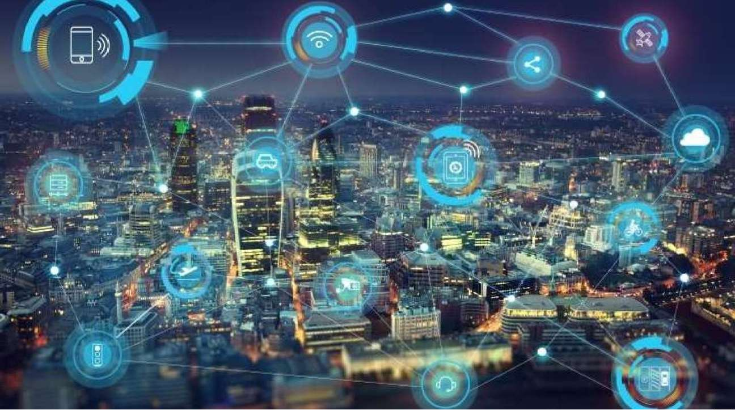



Slide 2



Opportunity ToLeverage
The MOMENT OF TRUTH
EYE LEVEL IS BUY LEVEL
70% of purchase decisions are made in the store
68% of shoppers said that in-store messaging way their product purchase decisions
COMMUNICATION INSTORE LEADS UPTO 15% INCREASE IN SALES IN SUPER / HYPERMARKETS
Source:engageinstore.com,Adweek.com,signindustry.com from a presentation made by Aisle Three

Slide 3

MOST IMPORTANT POTENTIAL TO TOUCH ALL HUMAN SENSORY
Sampling
Product Display
Visuals
Fragrances Aroma
In-store Radio

Slide 4







Strengthening mind measure and/or sales measure matrix for the brand
Creating engagement with customers in retail environment
Building solution to enhance customer experience inside Retail store

Slide 5
AUTOMOBILE CAMPAIGNS

Slide 6
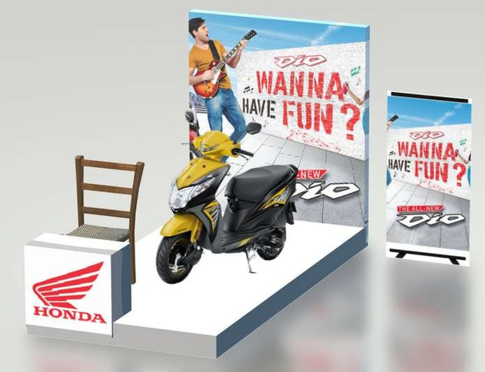
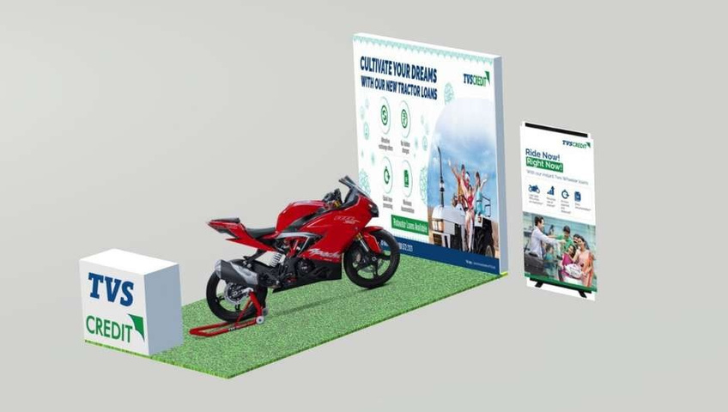
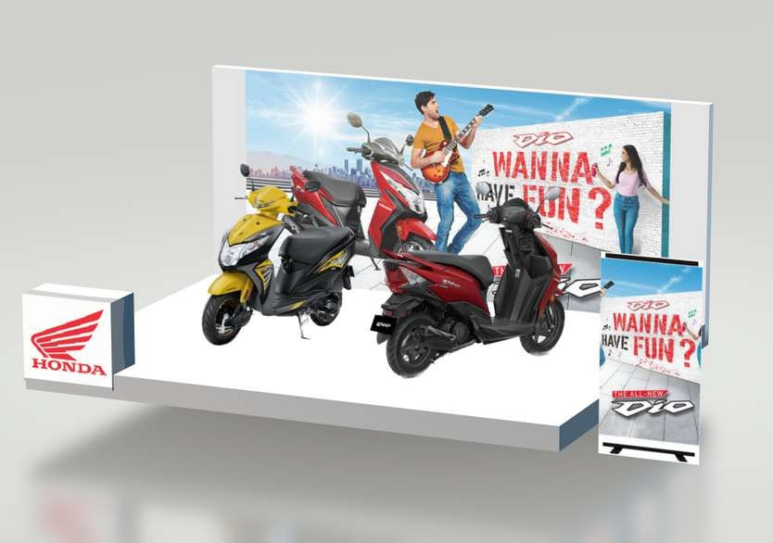
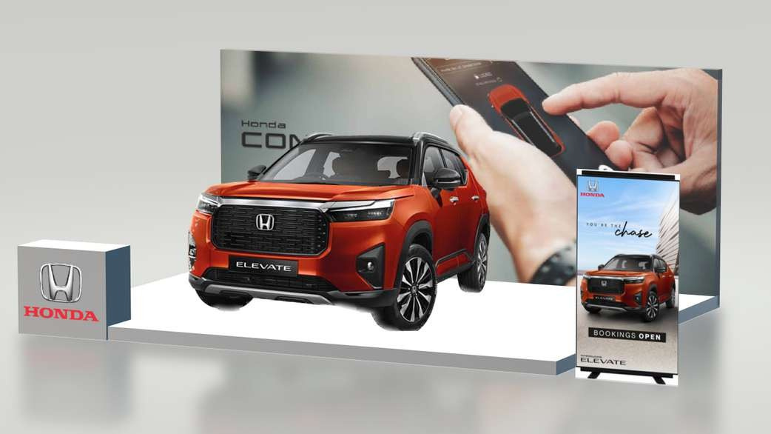

3D Models For Understanding

Slide 7
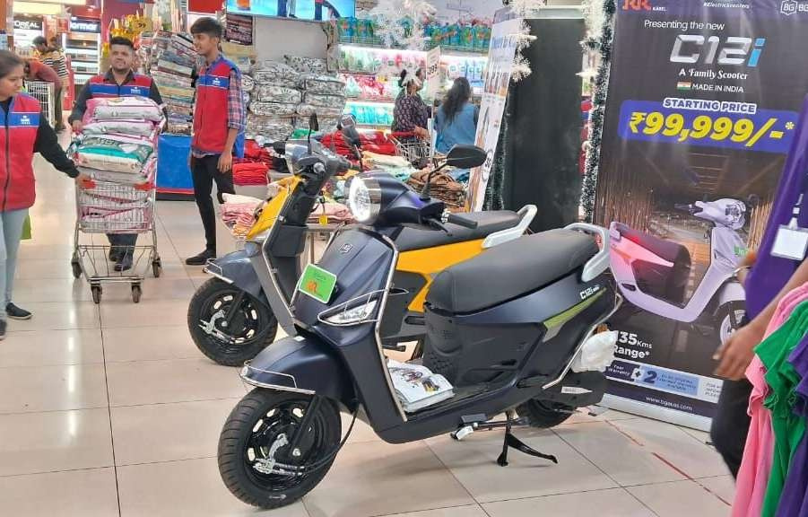
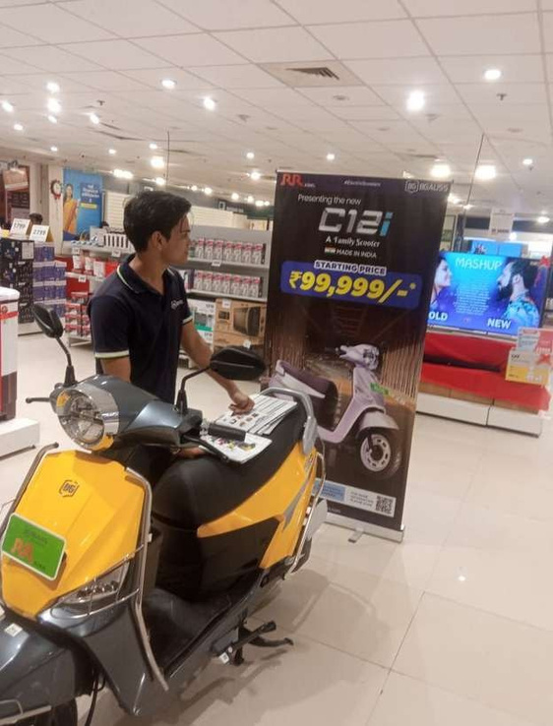
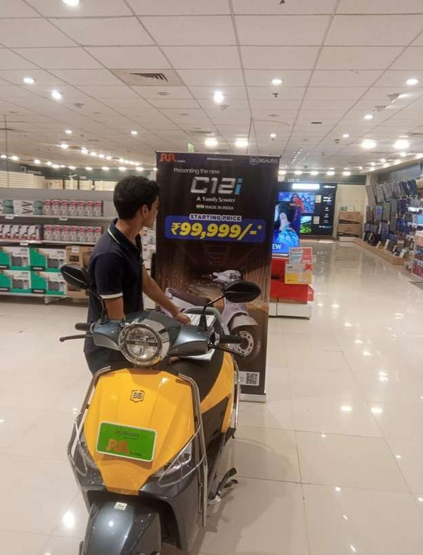

Slide 8
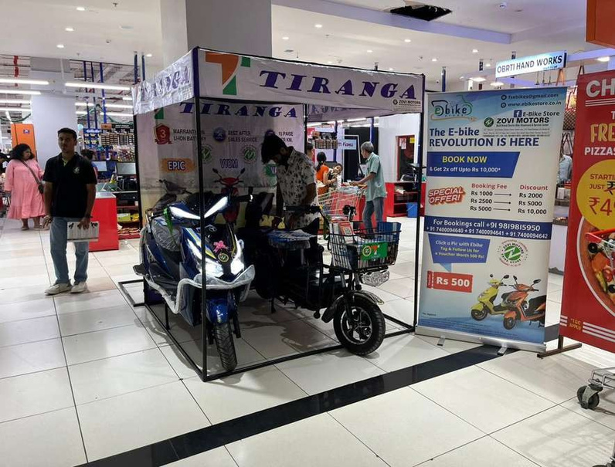
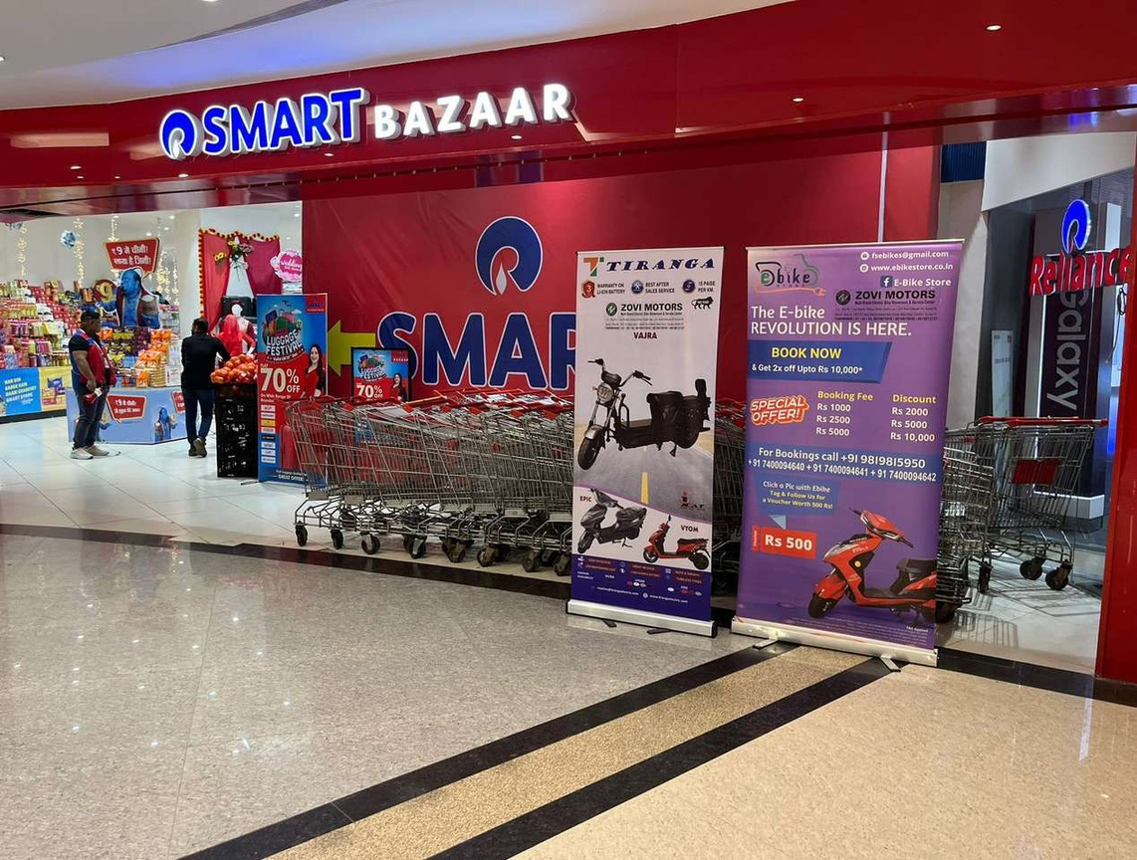
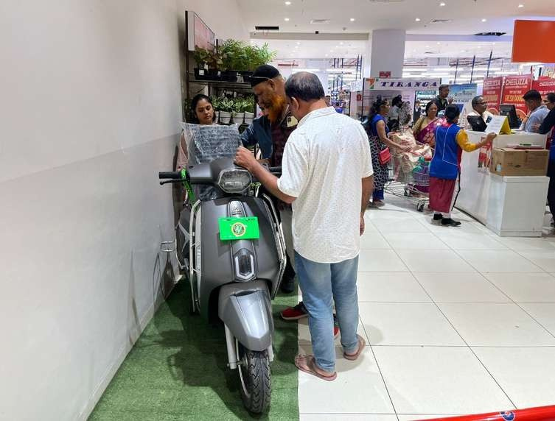

Slide 9
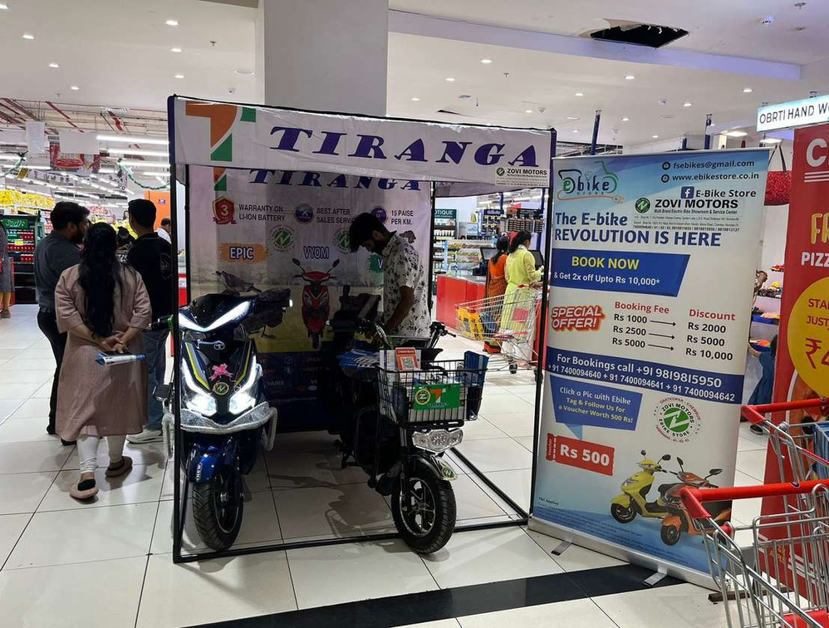
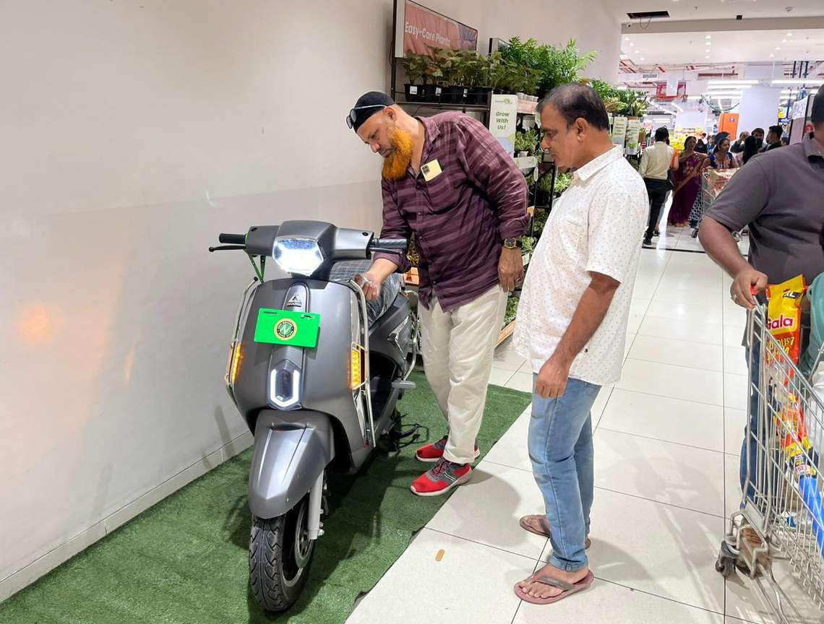

Slide 10
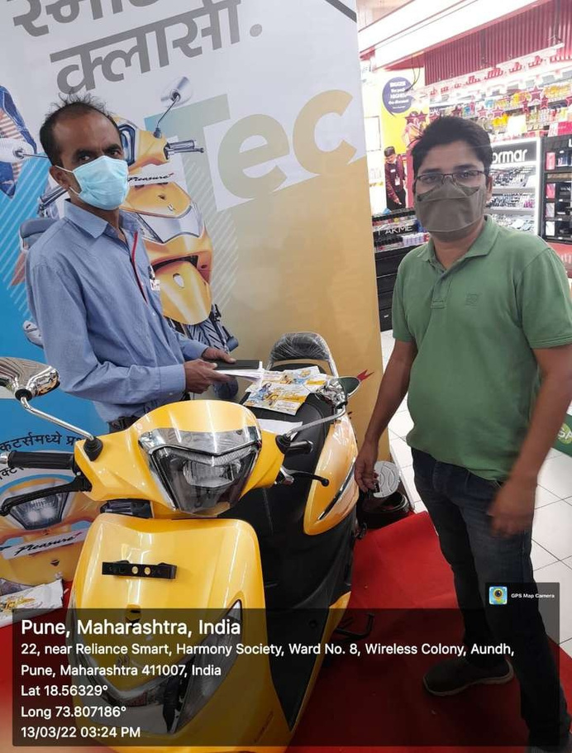
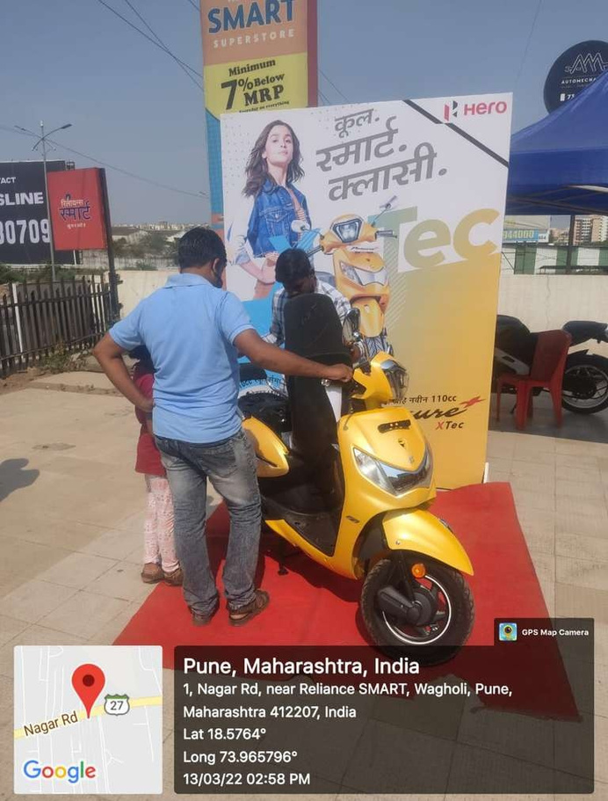
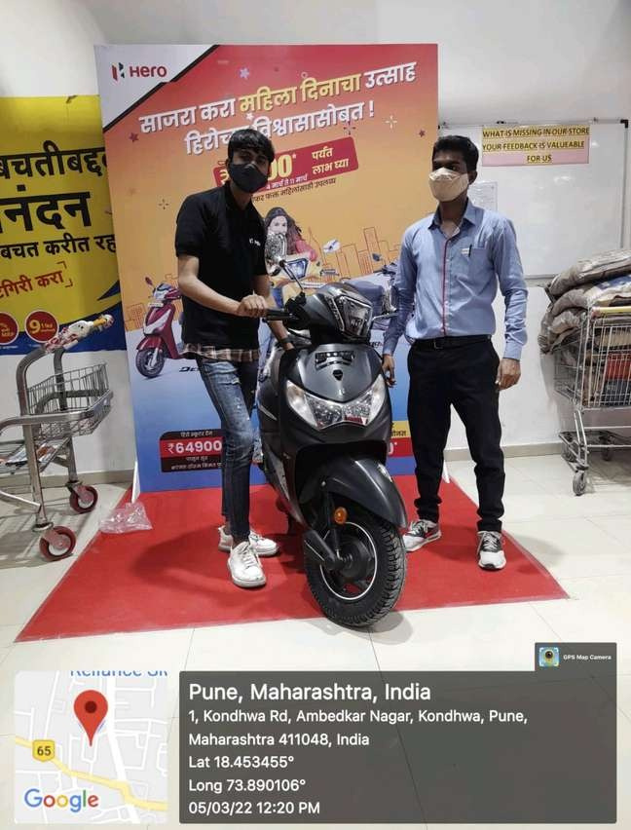

Slide 11
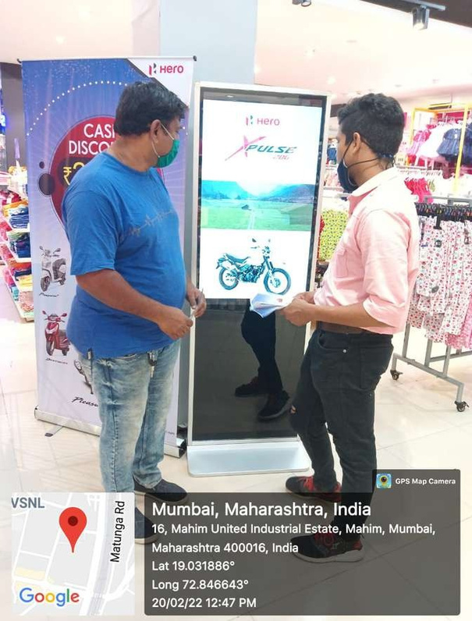
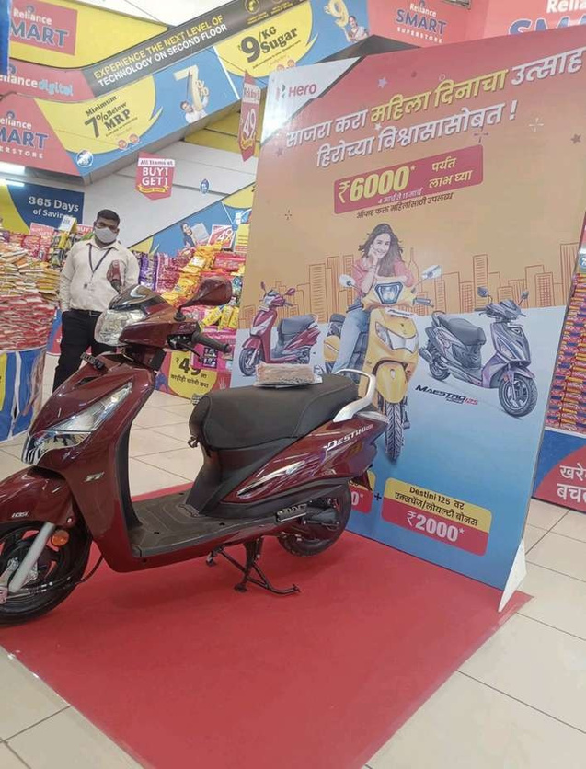
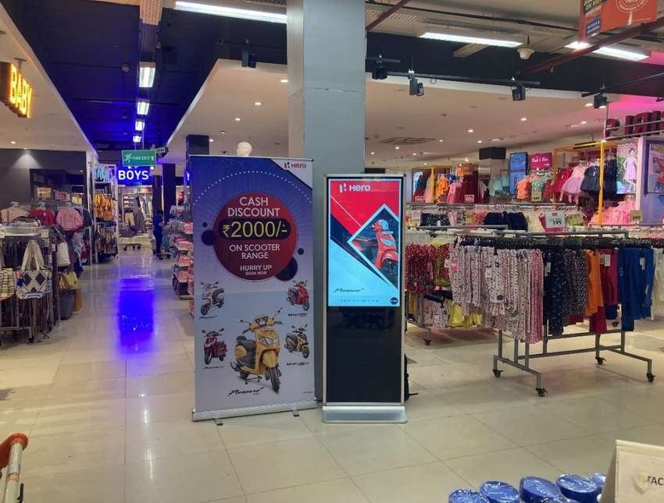

Slide 12
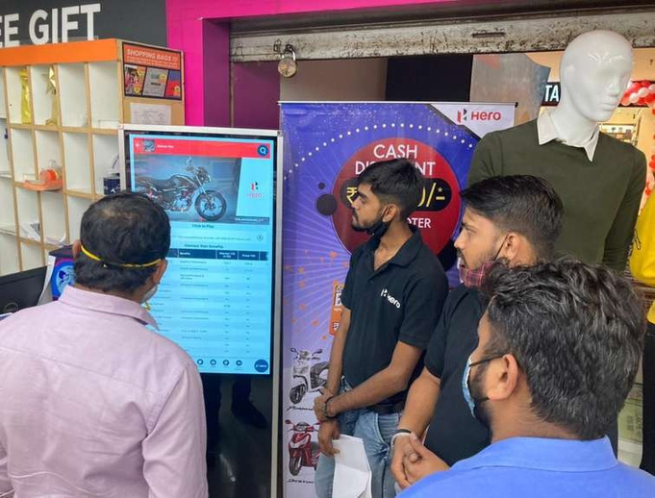
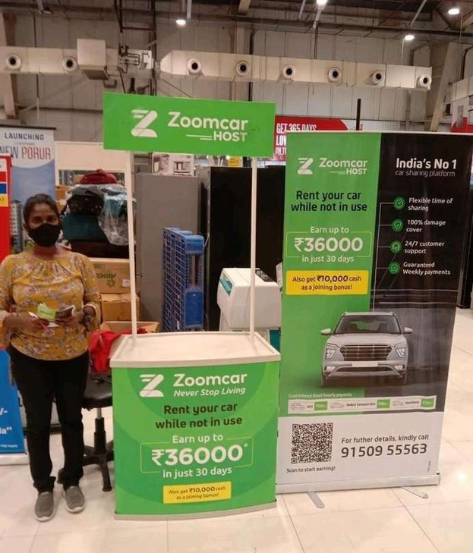
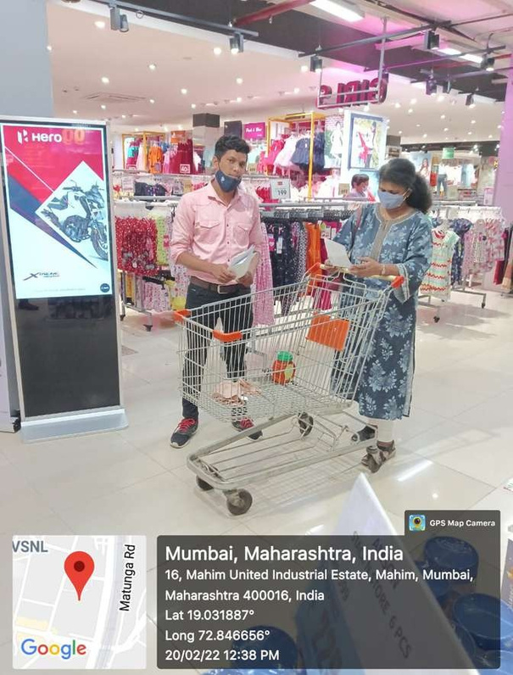

Slide 13
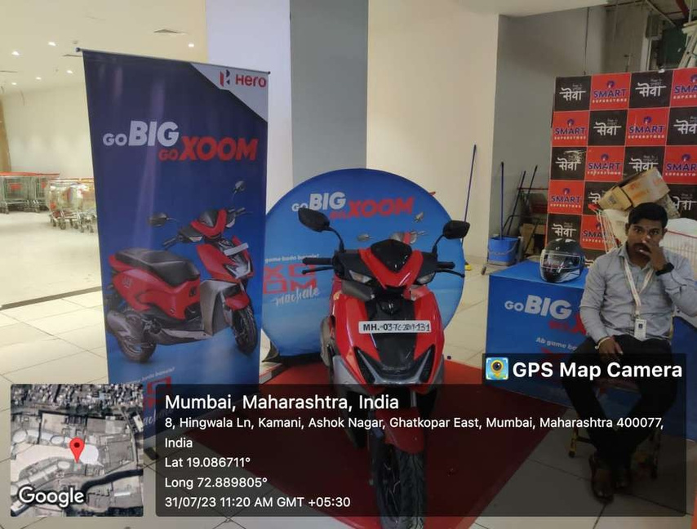
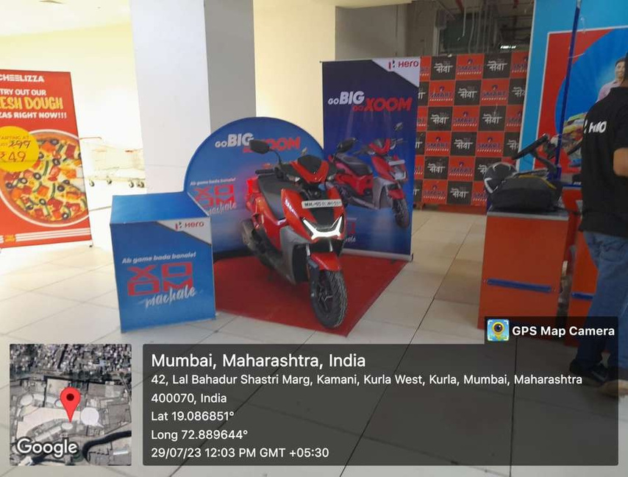
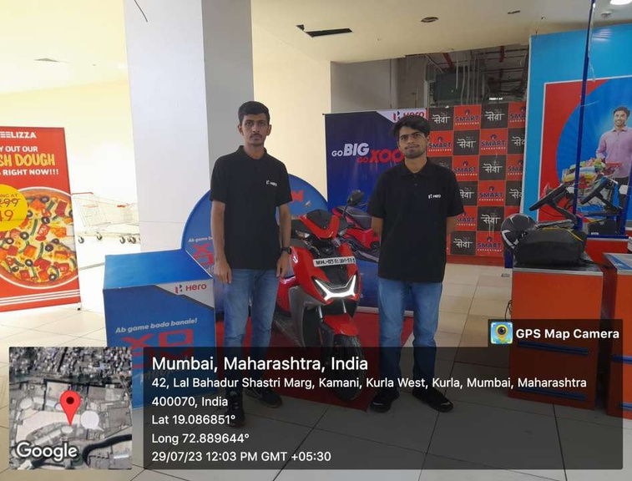
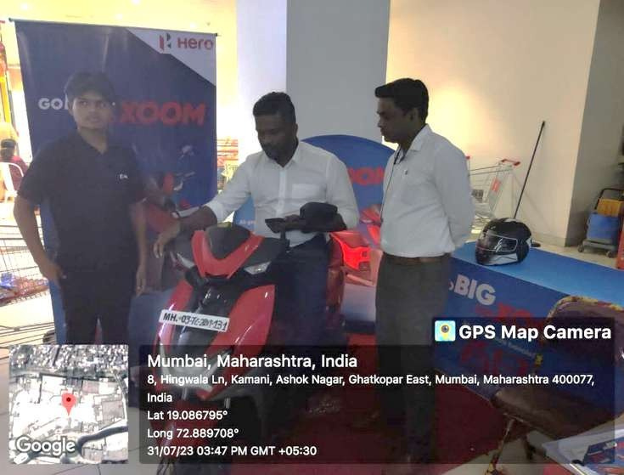

Slide 14
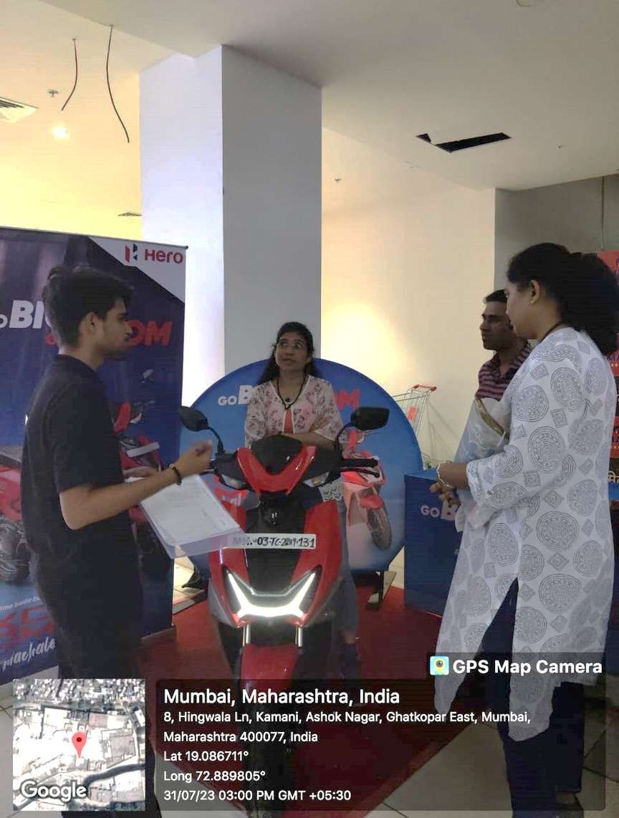
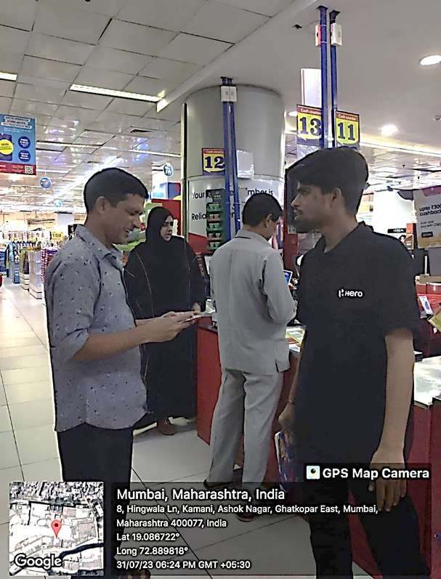
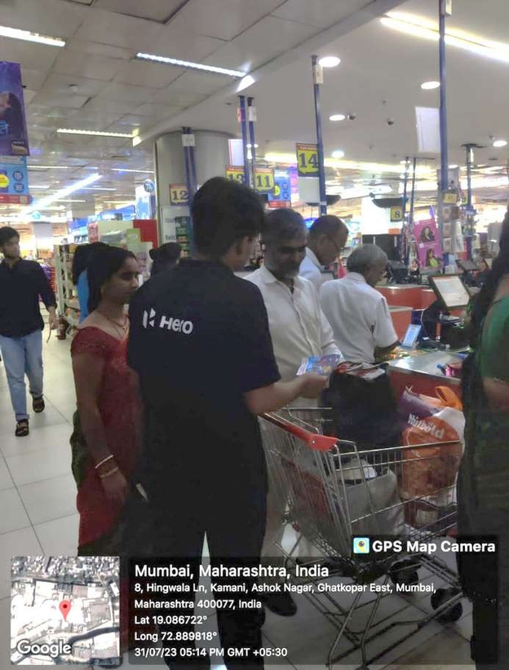

Slide 15
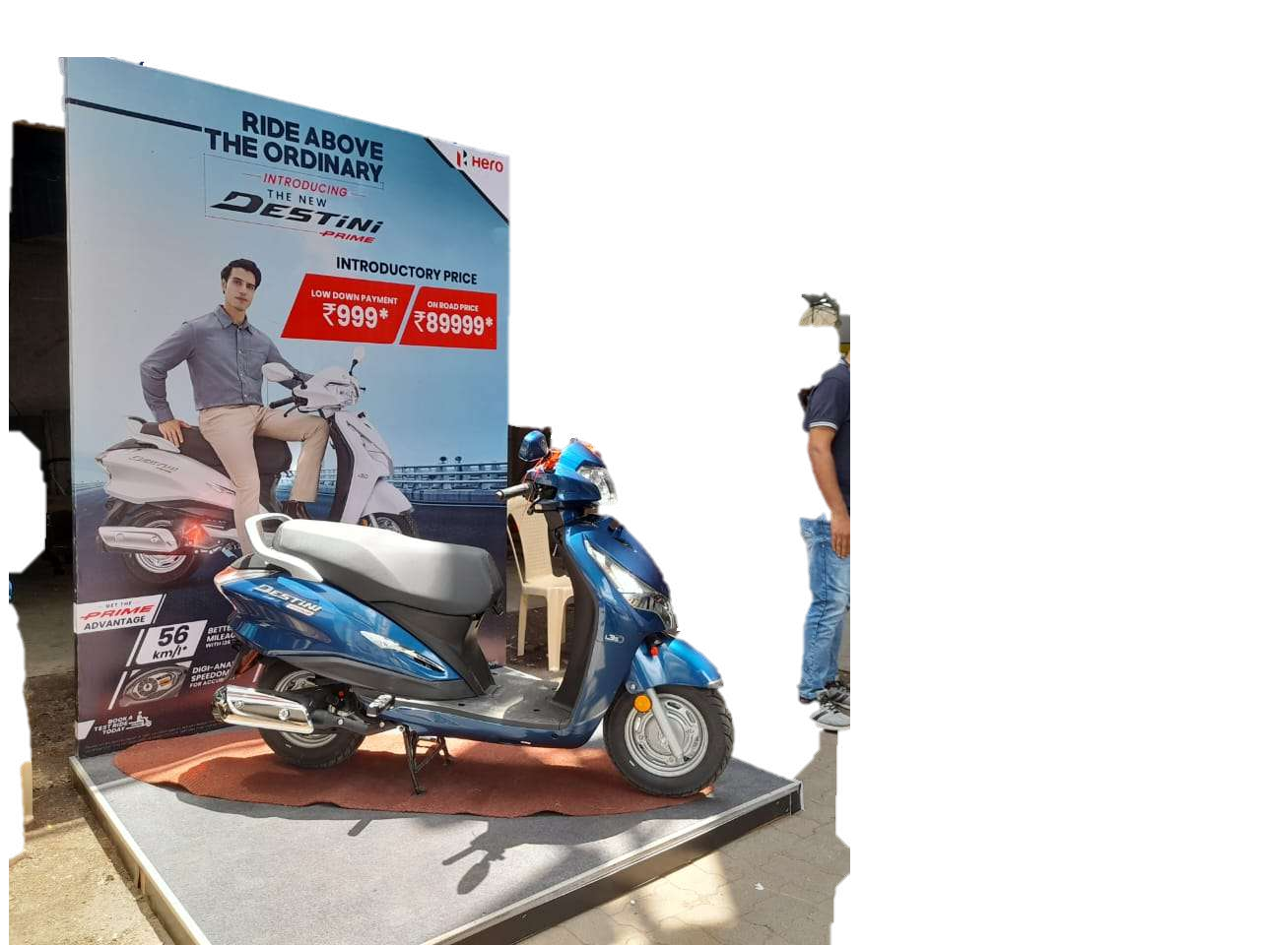
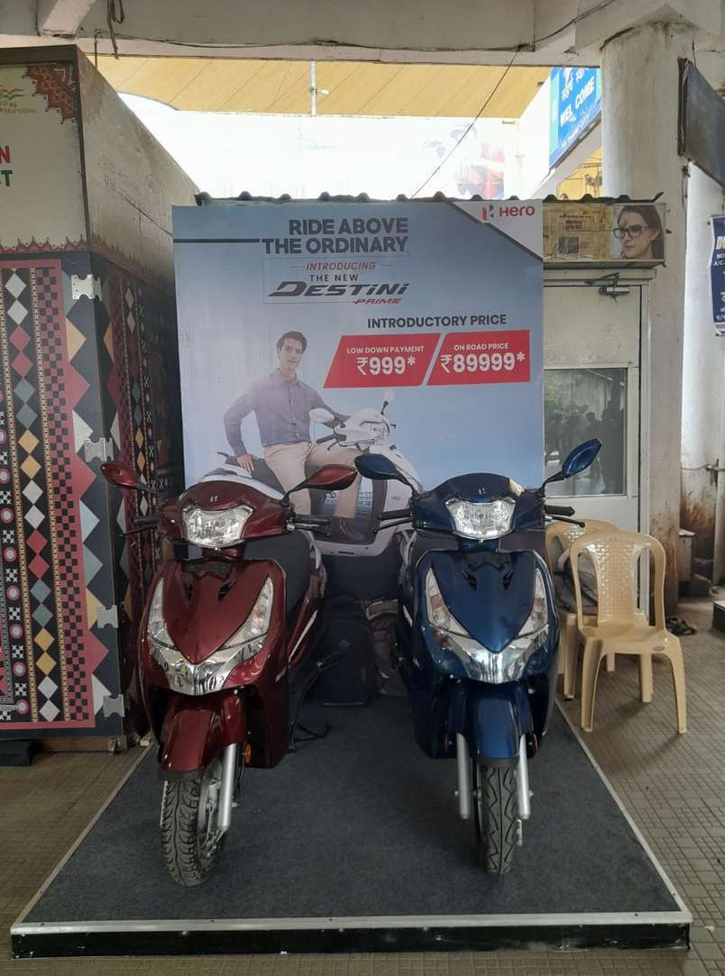

Slide 16
REAL ESTATE CAMPAIGNS

Slide 17
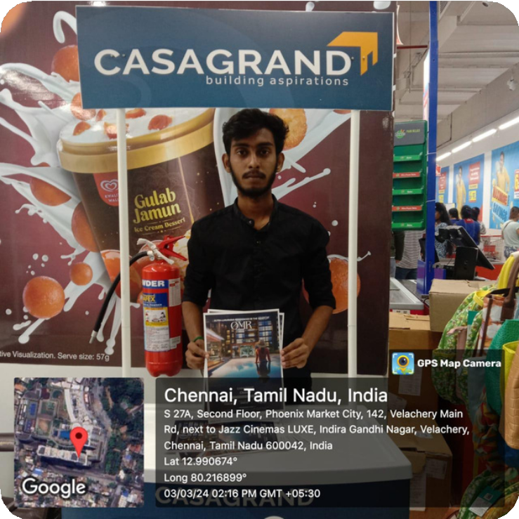
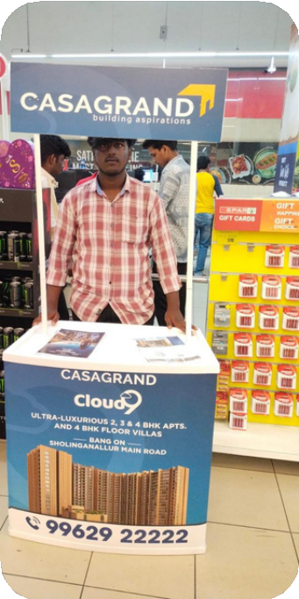

Slide 18
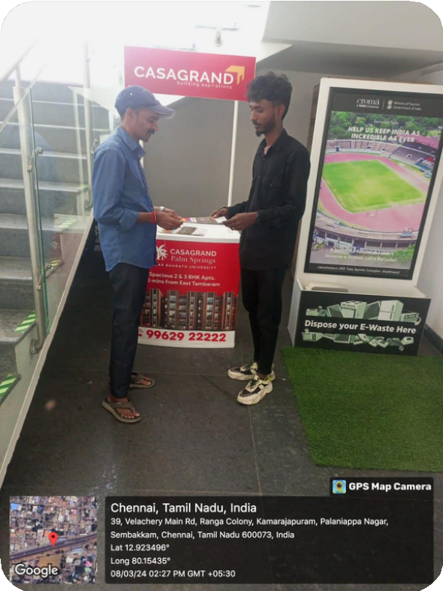
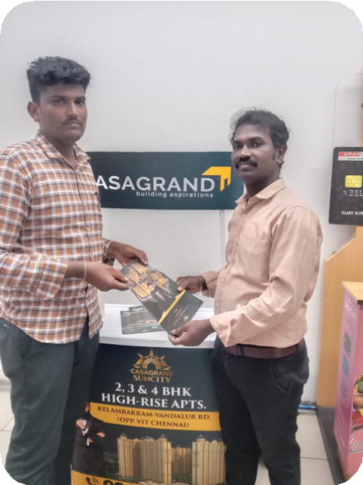

Slide 19
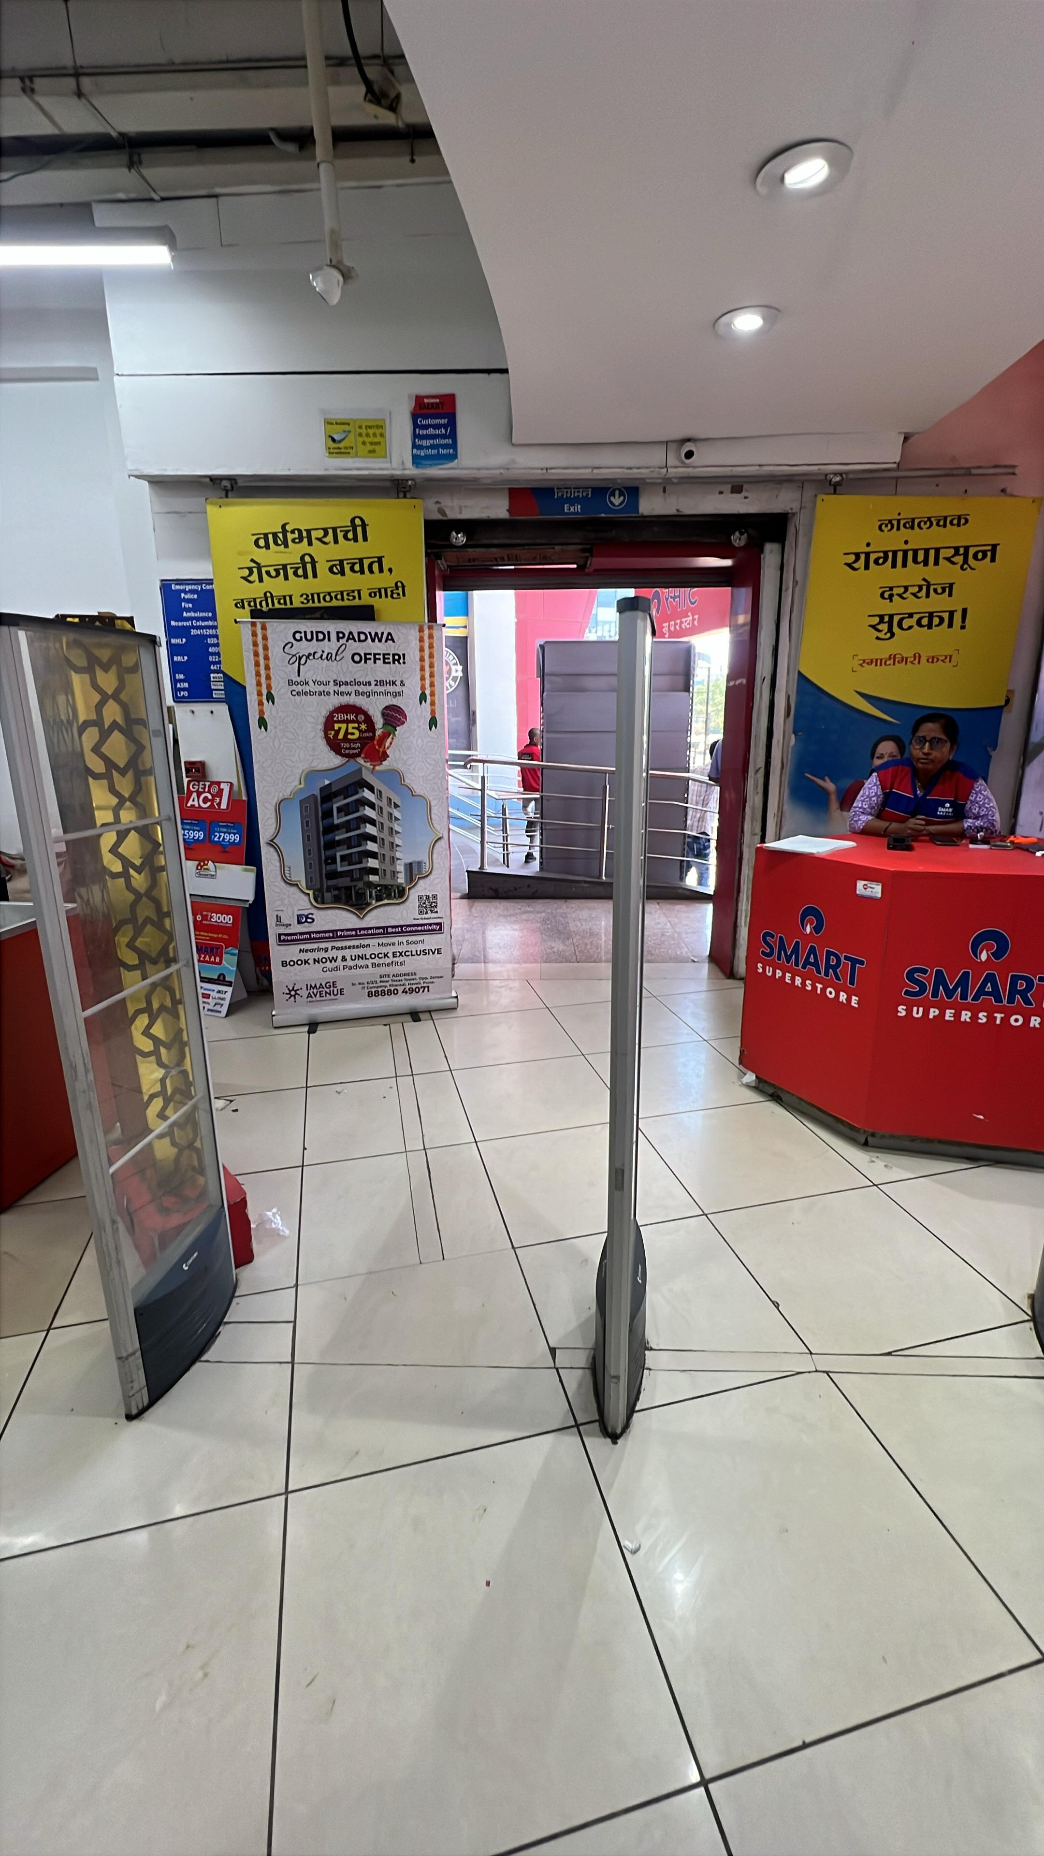
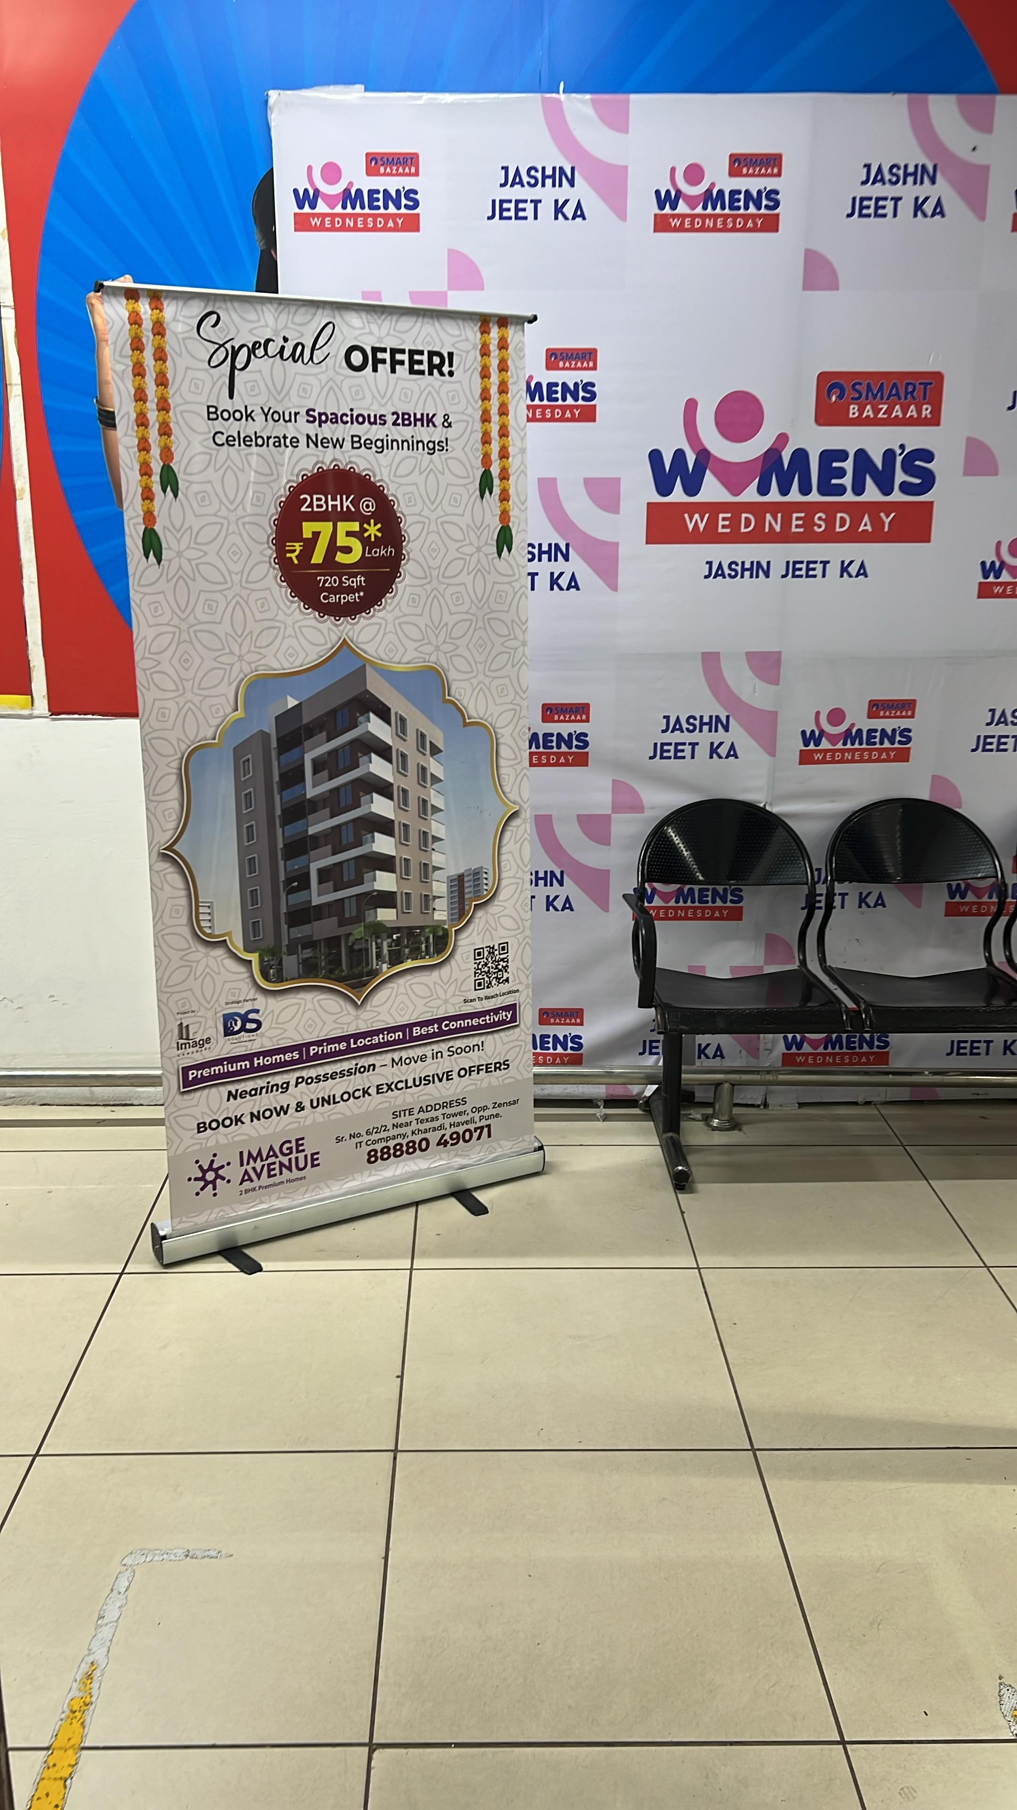

Slide 20
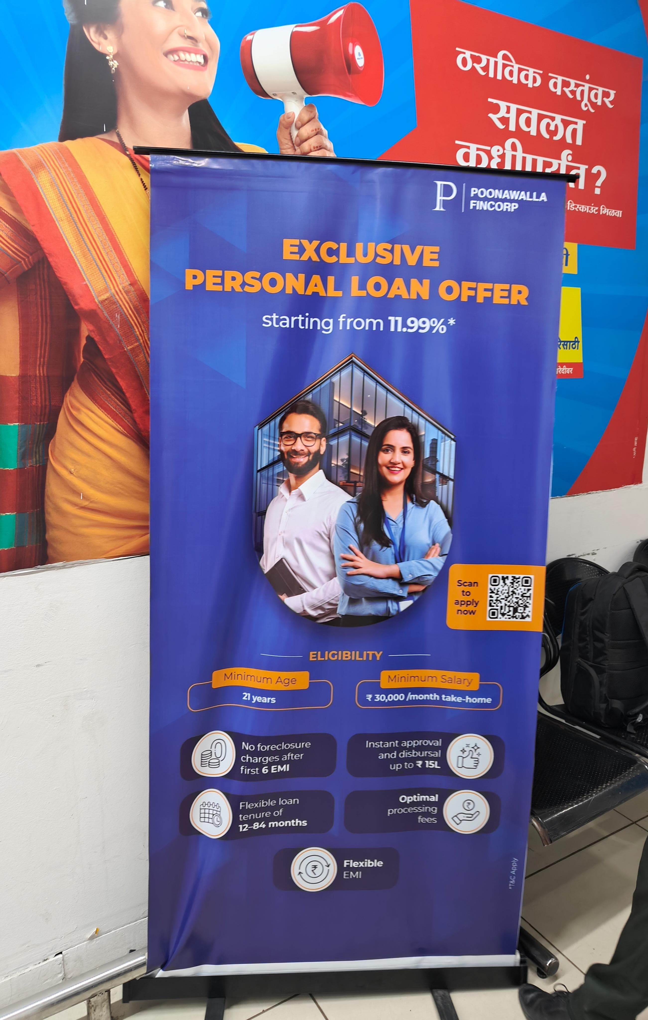
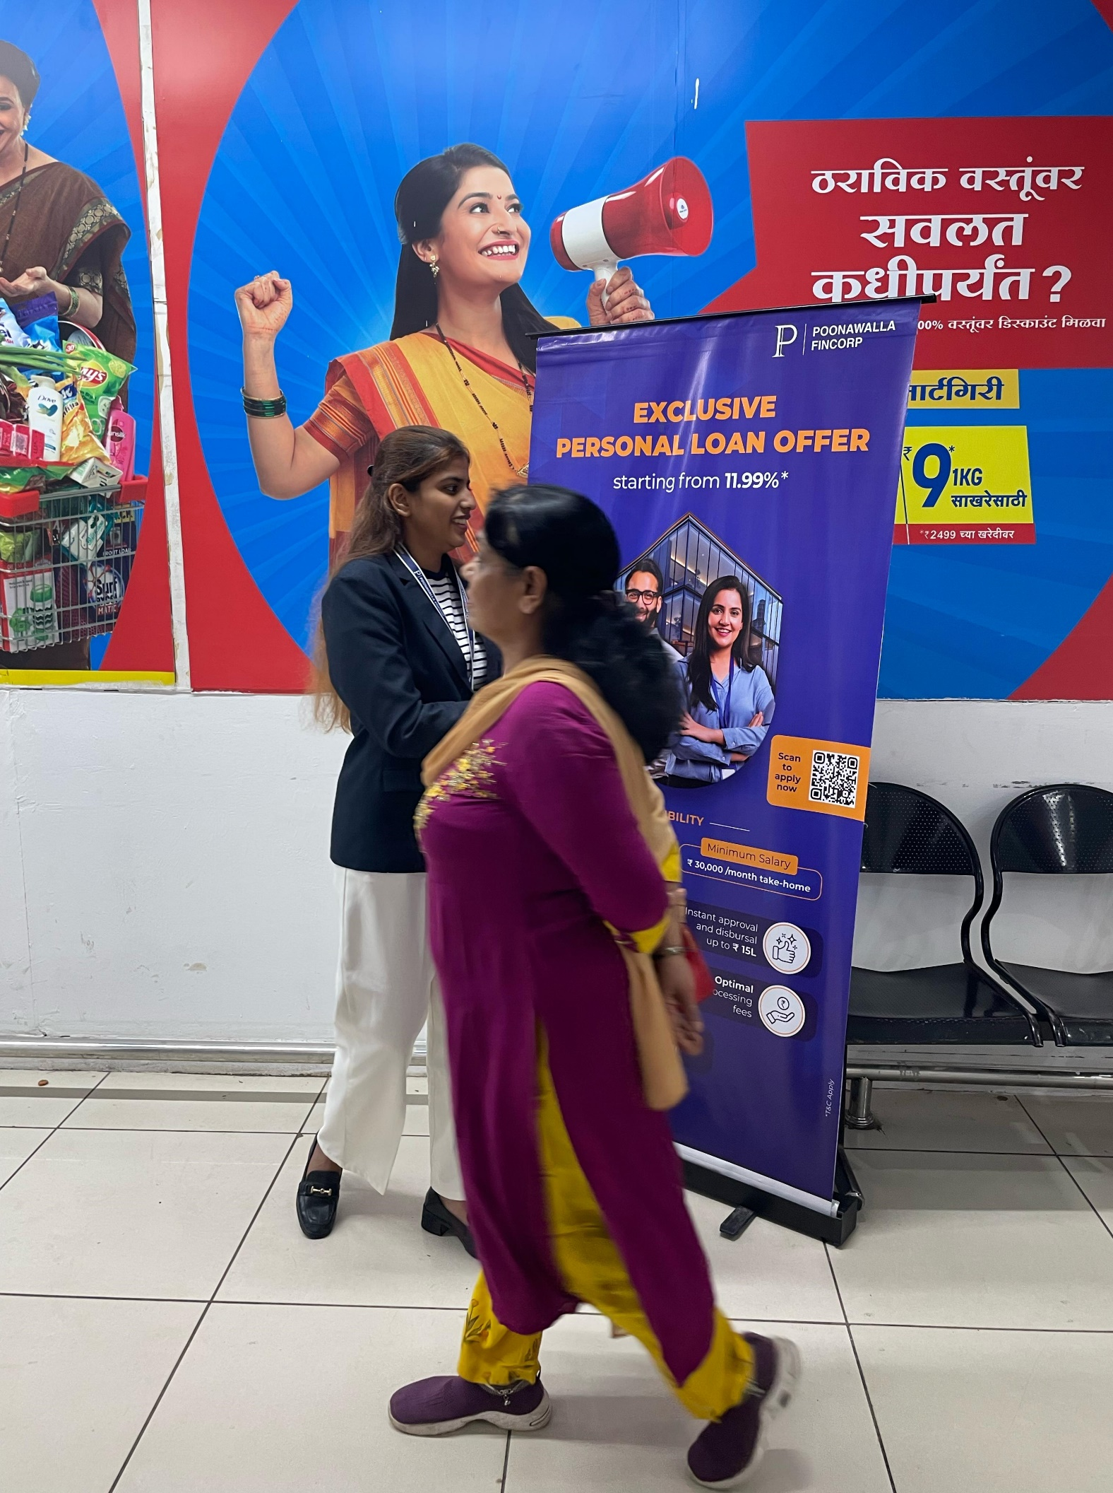

Slide 21
BANKING & INSURANCE CAMPAIGNS

Slide 22
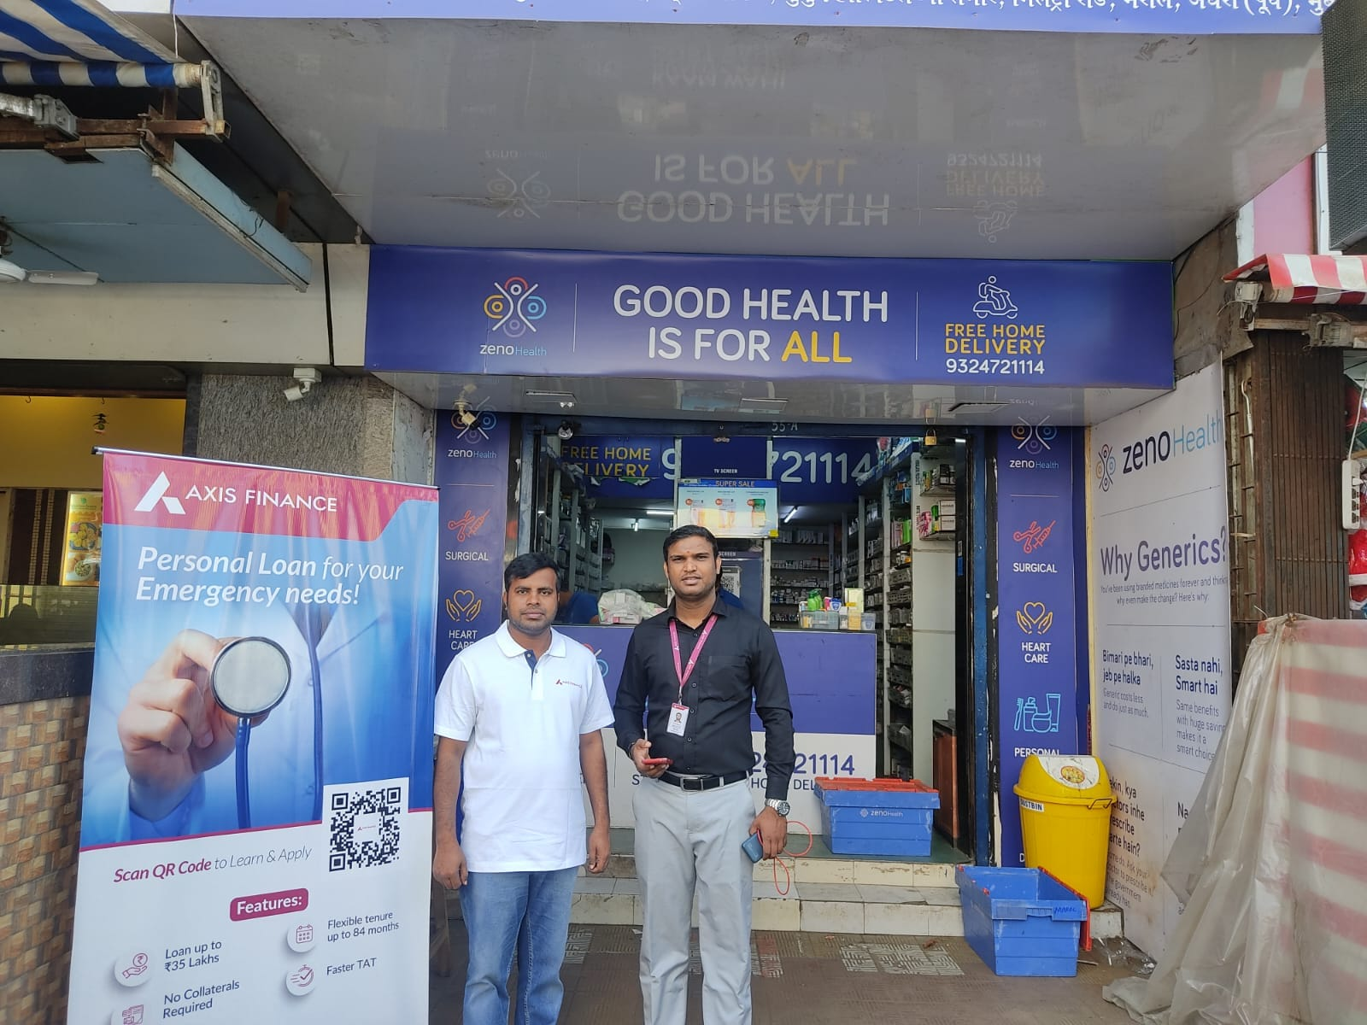
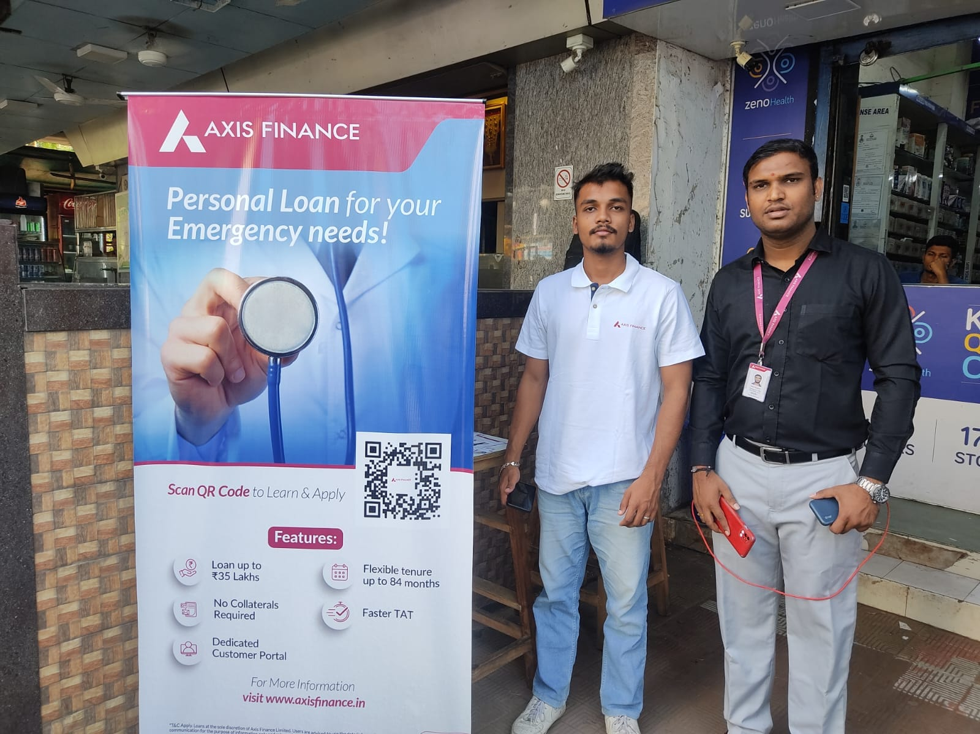

Slide 32
Our Services Pan India:
Mall Activation.
Multiplex & Single Screen Activation
Retail Shops Activation.
Hyper Markets Activation.
Electronic Store Activation.
Society Activation
Gym / Club Activation.
Corporate Park Activation.
Corporate Offices & Food court Activation.
Theme Park & Water Park Activation.
Street , Parks & Club Houses Activation
Temple Branding
Foodcourt, Restaurants & Dhabha Activation
School Activation
College Activation.
Exhibition Stall Designs & Fabrications.
Special IP’s Partners Activations.
Sponsorships & Brand Alliances
In-film Branding & Awards Integrations.

Slide 33

THANK YOU !
DHIRAJ CHABBRIA
Director - Marketing
Mobile: +91 9870079884
Email: dc@sabmarcom.com / connect2sabmarcom@gmail.com

